Slide 1
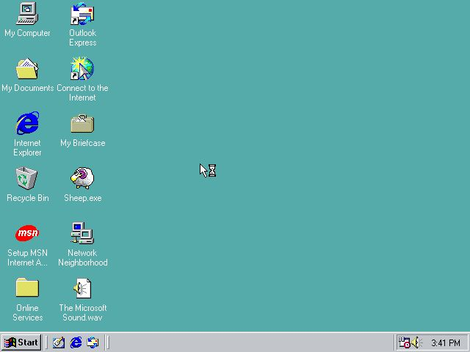
Midterm Proposal
Abrar Almari

Slide 2
Concept and Site theme
My concept for this midterm is a personal portfolio website. I plan on showcasing previous work from different classes as well as some added personality into the site design.

Slide 3
Site map
About
Home page
Projects
Still images
Videos
Designs

Slide 4
Wireframe

Slide 5
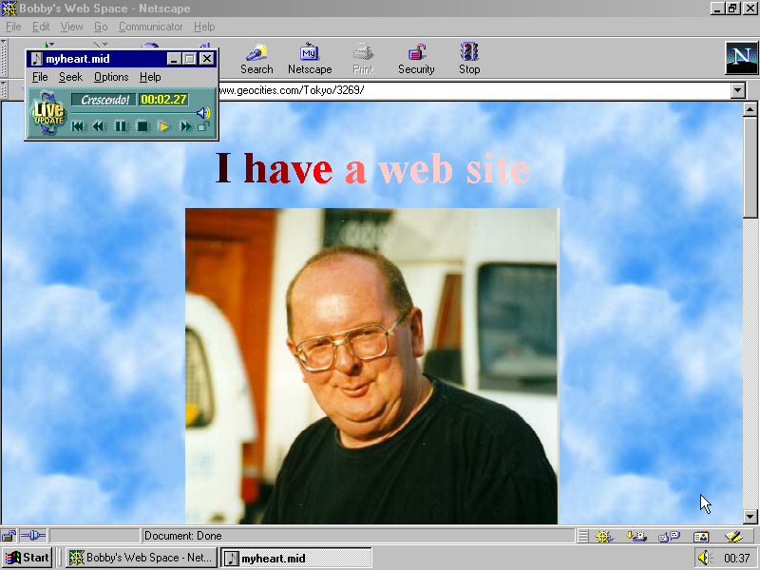

Inspiration
early internet styles, nostalgic web diaries: neocities,

Slide 6
Pinterest board

Slide 7
Skills
Skills that will be used:
Inserting images and using alt text
Nav links
Html forms: margins, paddings, flex boxes
Css and Semantic markups
Skills needed:
How to include more stylistic elements similar to my inspiration
Homepage: how to have posts appear by most recent
Projects page: how to have the posts appear chronologically (when first created)

